Slide 1

My Cloverbud Adventure Portfolio
Barron County 4-H
About me:
My Name: ________________________________________
My 4-H Club: _____________________________________
My Grade in School (4-H year): _______________________
I have been in 4-H for _____year(s).

Slide 2
Your Cloverbud Yearly Record
Dear Cloverbuds,
As a Cloverbud, you can try new things, do projects, have fun, and learn with other 4-H members. Cloverbuds are kids in Kindergarten, 1st Grade, and 2nd Grade.
This Yearly Record is a place to show what you did during your 4-H year. You can use these pages to write about your projects, activities, and fun experiences. You can also add other things you want to share (add as many pages as you would like).
At the end of the year, give your completed Record Book to your 4-H club leader. Most clubs collect Record Books in August or September.
When you go into 3rd Grade, you will make a Showcase like the older 4-H members. Keeping this Cloverbud Record will help you learn how to do that and celebrate all the great things you do in 4-H.
Your parents and 4-H leaders can help you fill out this book, but the work should be your own. Have fun showing what you learned and did this year
My 4-H Activities (check off the activities you did this year!)
⃞ Went to 4-H Club Meetings
⃞ Helped my Community
⃞ Did a Demonstration
⃞ Participated in County Event
⃞ Made new friends
⃞ Went to Project Discovery Day
⃞ Entered in the Fair
⃞ Other:______________________
⃞ Other:______________________
⃞ Other:______________________
⃞ Other:______________________
⃞ Other:______________________

Slide 3

I am a Cloverbud!
This is a photo of me:
My favorite thing about 4-H this year has been:

Slide 4

My 4-H Story
Share a favorite memory, what you are proud of, skills you developed, and/or what you want to do in 4-H next year (pictures and/or words)!

Slide 5
Learning & Exploring
As a Cloverbud, you get to try many new things! You might learn about animals, plants, cooking, art, science, nature, and helping others. Every year is a chance to explore, learn, make friends, and have fun in 4-H! Share about something you learned or explored this year in 4-H.
Here are Photos or Drawings of me Learning & Exploring:

Slide 6
My 4-H Year
Think about all the fun things you did in 4-H this year. Use this page to share pictures, drawings, and words about your favorite 4-H activities and memories.

Slide 7
List some things you would like to do next year:

Slide 8
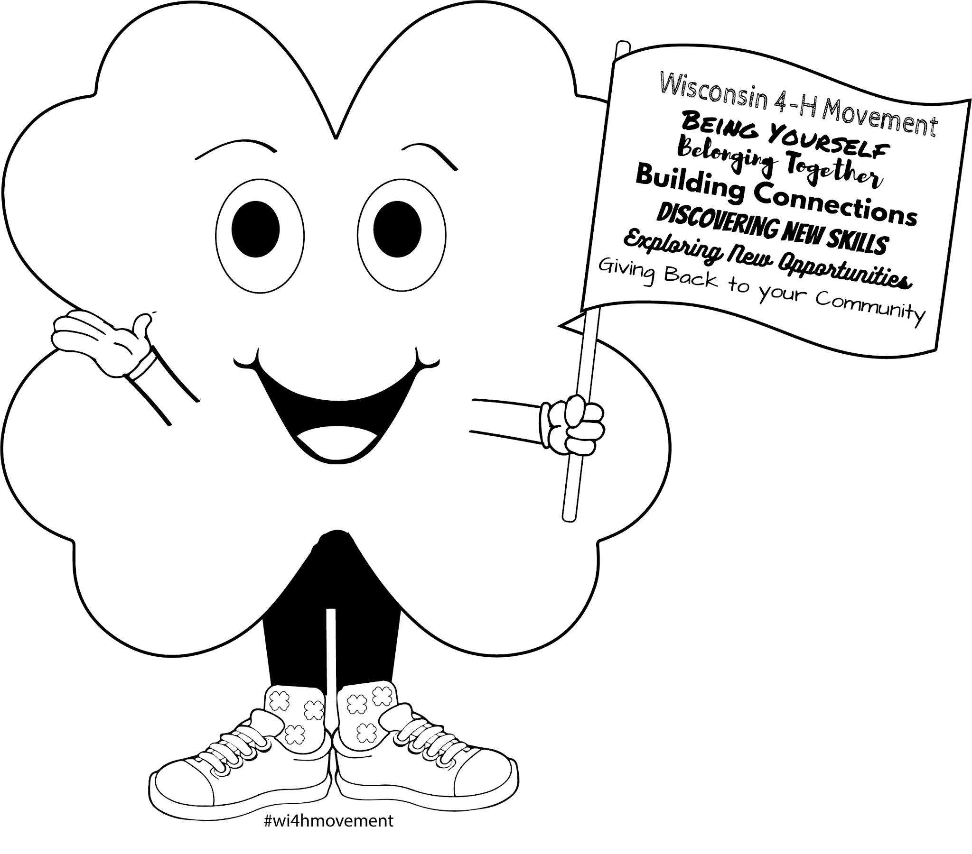
Flag Pledge
I pledge allegiance to the flag of the United States of America, and to the republic for which it stands, one nation under God, indivisible, with liberty and justice for all.
4-H Pledge
I Pledge
...My Head to clearer thinking
...My Heart to greater loyalty
...My Hands to larger service, and
...My Health to better living, for my Club, my Community, my Country, and my World.
4-H Club Emblem: The four-leaf clover
4-H Club Colors: Green and White
4-H Club Motto: “To Make the Best Better”

